Slide 1
Why do I MOOC?
One learner’s experience
Sally-Anne Betteridge
University of Birmingham

Slide 2
About Me
Graduate Trainee in Professional Services
International Student Transitions in Engineering and Physical Sciences
Library Services
Registrar and Secretary’s Office
Now
2012
University of Birmingham
Childhood, Culture and Education
Before
A Levels and GCSEs
Other
Guide and Brownie Leader, Online Assistant for Jump! Magazine and Volunteer with Let Toys Be Toys

Slide 3
MOOCS?
Curiosity and interest
Professional Development
Continuing ‘academic’ study
Why
When
Summer 2012, just after graduation
What
Coursera – Gamification and Education & Digital Cultures

Slide 4





Gamification
University of Pennsylvania
No statement of accomplishment
Oct
Education and Digital Cultures
University of Edinburgh
Statement of Accomplishment
Jan
Aboriginal Worldviews on Education
University of Toronto
Statement of Accomplishment with Distinction
Feb
The Camera Never Lies
University of London International Programmes
Currently completing
Jun
Art and Inquiry: Museum Teaching Strategies for Your Classroom
Museum of Modern Art
Pre-enrolled
Aug

Slide 5




WAGGGS Leadership Development Programme
WAGGGS/University of Reading
Stage 1 completed
May
Enrolled
Introduction to Operations Management
University of Pennsylvania
TechniCity
The Ohio State University
Design: The Creation of Artefacts in Society
University of Pennsylvania

Slide 6
What do I think?
Favourite course didn’t have any!
Where lectures were used, preferred Gamification
Do NOT like recordings of proper lectures
Lectures
Prefer ‘in-course’ assessments
Not endless multiple choice quizzes
Did complete optional assessments
Assessment
Prefer using Twitter to Discussion Boards
Found it better where this was encouraged
Would consider going to a meetup
Interaction

Slide 7
Course Resources
Usually open access documents
Some issues with geographically limited resources
Often links to the BBC etc
Access
Didn’t tend to actually read them
Skimmed for answers for quiz
Reason for preferring other types of assessment
Usage

Slide 8
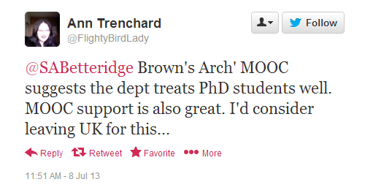
What was the point?
New experience and ideas
Enjoyment and something to do
NOT any real academic purpose
Would not be interested in paying
Have looked at university courses

Slide 9
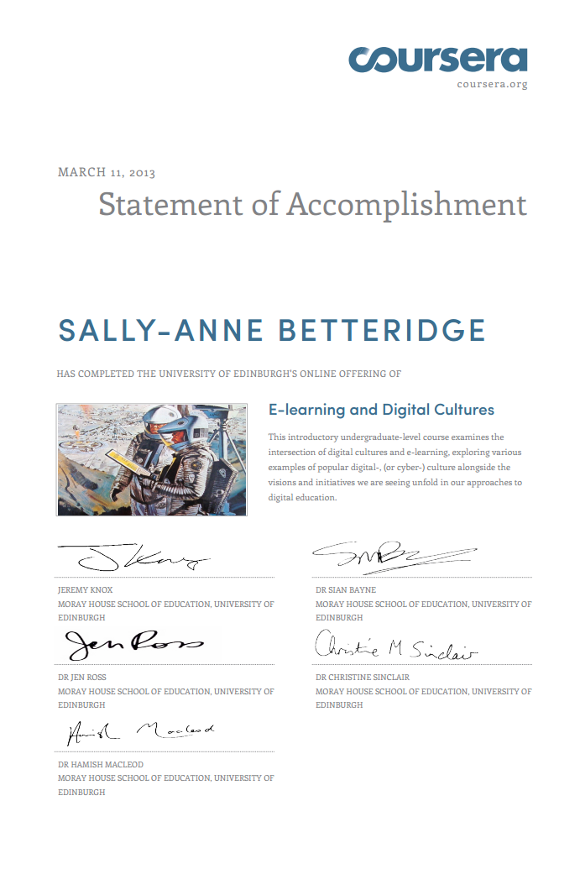
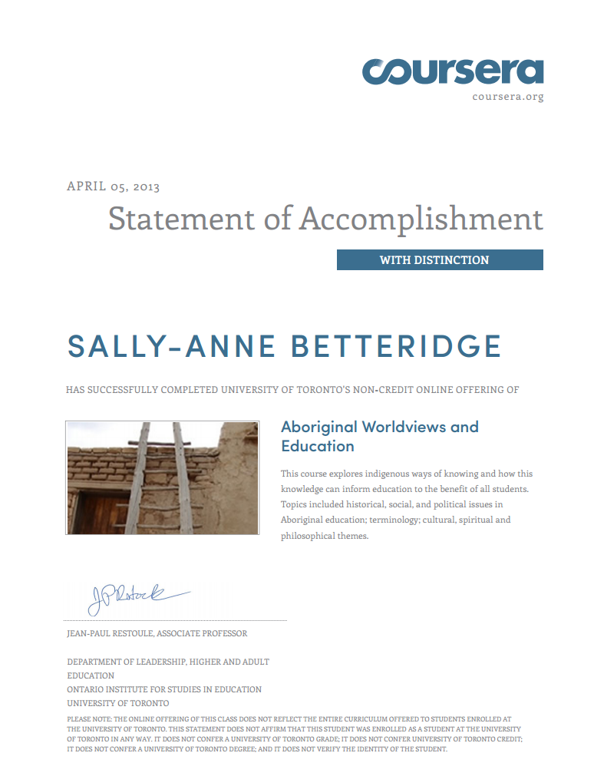
Coursera images and certificates: www.coursera.org
WAGGGS logo and course: www.wagggs.reading.ac.uk/
Tweet: https://twitter.com/FlightyBirdLady/status/354191088669560834
Images

